Slide 1


SDP
LECTURE
State Machines
Software Design Patterns
Diploma in IT
Year 2 (2024/25), Semester 4
2.2
Notes:
Hi everyone! Next up this week, we will be talking about something called a state machine. In many systems, there are objects in the system that act differently depending on the state they are in. For example, in a video game, a Quest object might have several states, such as a Pending state, an Active state, an Expired state or a Completed state. Depending on what state it is in, the Quest object acts differently, so maybe the hero can only pick up Quests in the Pending state. A state machine describes what states an object can be in, and how it acts depending on its current state.

Slide 2
Objectives
In this lesson, you will learn
What is state machine
When we should use a state machine to model the life cycle of an object
How to model object life cycles using state machines
UML notation
How to add control using junction or choice pseudostates
Notes:
We will start off this week’s lesson by explaining || what is a state machine, and also discuss || when we should use a state machine to model how an object behaves. We will then show you some || examples of basic state machines expressed using UML notation. Finally, we add a bit of complexity by || introducing ways to control the flow of state machines based on some condition, just to mix it up a bit. We have quite a bit to cover, so let’s get started.

Slide 3



State
The state of an object is its current condition
The possible states of an object are limited by the type of the object
A Guard object could be Hostile, Neutral or Friendly
A Weapon object could be Fully Loaded, Partially Loaded or Empty
Notes:
We begin by talking about what is a state. Basically, the || state of an object is just its current condition. Since you are an object, you have one or more current states. For example, depending on whether you’ve had lunch, you could be in a Hungry state or a Full state. Depending on whether you are interested in this lesson, you could be in an Interested state or a Bored state, or possibly a Neutral state. And depending on whether you had enough sleep, you could be in an Alert state or Sleepy state. Or you could be in an Asleep state, and I have no idea because this is a recorded lesson, but I hope you’re still listening.
One thing to note is that the || possible states of an object are determined by the type of object. If we are talking about a || Guard in a game, it makes sense to model whether he is in a Hostile, Neutral or Friendly state since he may act differently depending on the state he is in. A || Weapon object could have the Fully Loaded, Partially Loaded or empty states. But it would not make sense for a Weapon to be Hostile, Neutral or Friendly.
Image sources:
https://www.freepik.com/premium-vector/set-face-expressions-man_13152285.htm

Slide 4
State
The current state of an object is determined by
The current value of the object’s attributes
The links that it has with other objects
E.g., the class StaffMember has an attribute startDate which determines whether a StaffMember object is on probation
Notes:
How do we know what is the state of an object? In a software system, || the current state of an object is determined by two factors: the value of its attributes, and the links it has with other objects. Let’s take an example from the SWAD textbook on the Agate Advertising Agency. Suppose there is a rule that all newly hired staff are on probation for the first 6 months. How would we know if a StaffMember is on probation? Well, it could be that || the StaffMember class has an attribute called startDate that records when the StaffMember was hired. We can then check if startDate is within 6 months of today’s date to see if that staffMember is in the OnProbation state.

Slide 5
State
Some objects may have only one possible state
The object behaves differently depending on its state
Conceptually, an object remains in a state for an interval of time
Notes:
Here are a few more aspects about states in software systems that you should know. || Some objects may only have one possible state, namely, it exists or has been created. For such objects, we would not bother to construct state machines for them.
It is important to note that not everything about an object is necessarily a state. In order to be considered a state for an object, that object || must behave differently based on its state. So if a Student object behaves the same in the system whether he is allocated to class T01 or T02, then which class the Student is allocated to is not a state of that Student in the system. Also, to qualify as a state, the object must be || in that state for an interval of time. For example, if a video game character can drink a potion to recover health instantaneously, then “Drinking Potion” is not a state, it’s just an action. More on actions later.

Slide 6
State Machine
An object may change states after an event (or trigger)
The loadWeapon event changes the state of a Weapon object from Empty to Fully Loaded
A State Machine models the possible states of an object and how it moves from state to state
Notes:
Objects can change states. This happens when either its attribute or links to other objects changes, which occurs after an event or trigger. So the || loadWeapon event might change the state of a Weapon object from Empty to Fully Loaded. Depending on the object, how it changes states and how that changes its behavior can get quite complicated, which is why we have state machines. || A State Machine models the possible states of an object and how it moves from one state to another, and a state machine diagram is a pictorial representation of this set of interactions.

Slide 7
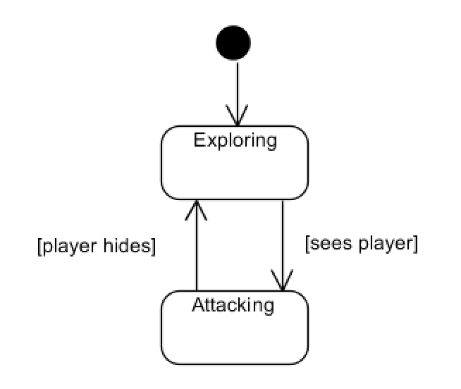
State Machine
Example: Patrol object in a video game
Initial pseudostate
States
Transitions
Notes:
Let’s see a simple example of a Patrol object in a video game, which is an NPC mob that is patrolling an area. This state machine has two states. When the Patrol object is first created in the game, it goes to the Exploring state. You know it starts off in Exploring state because of the black circle pointing to it. It will stay in the Exploring state until it sees the player, then it will go to the Attacking state. But when it loses sight of the player, it will go back to Exploring state.
Here is the terminology used in UML. These rectangles with rounded corners are called || States, and these arrows are called || Transitions. Note that the transitions are labeled with what causes the object to move from one state to another, and we’ll explain why they are in square brackets later. And the || black circle pointing to the starting state is called the Initial Pseudostate.
Congratulations! You have now seen your first state machine. That’s pretty easy to understand, right?

Slide 8
State Machine Example
Example: In the Agate Advertising Agency system, every StaffMember is paid based on their GradeRate.
The possible states for a GradeRate object are Pending, Active or Lapsed.
The current state of a GradeRate object can be determined by the two attributes rateStartDate and rateFinishDate
Notes:
Now, let’s look at a slightly more complex example in the Agate Advertising Agency case study from the SWAD textbook. In that system, every StaffMember is assigned a GradeRate object which determines how much they are paid, and the GradeRate object can be in || one of 3 states, either Pending, Active or Lapsed. Each GradeRate object has || two attributes called rateStartDate and rateFinishDate, which are the dates when the grade will start and finish, respectively. The way this works is that if the current date is before the rateStartDate, then the GradeRate is in Pending state. If it is after the rateStartDate but before the rateFinishDate, then it is in Active state. If it is after the rateFinishDate, then it is in the Lapsed state.

Slide 9
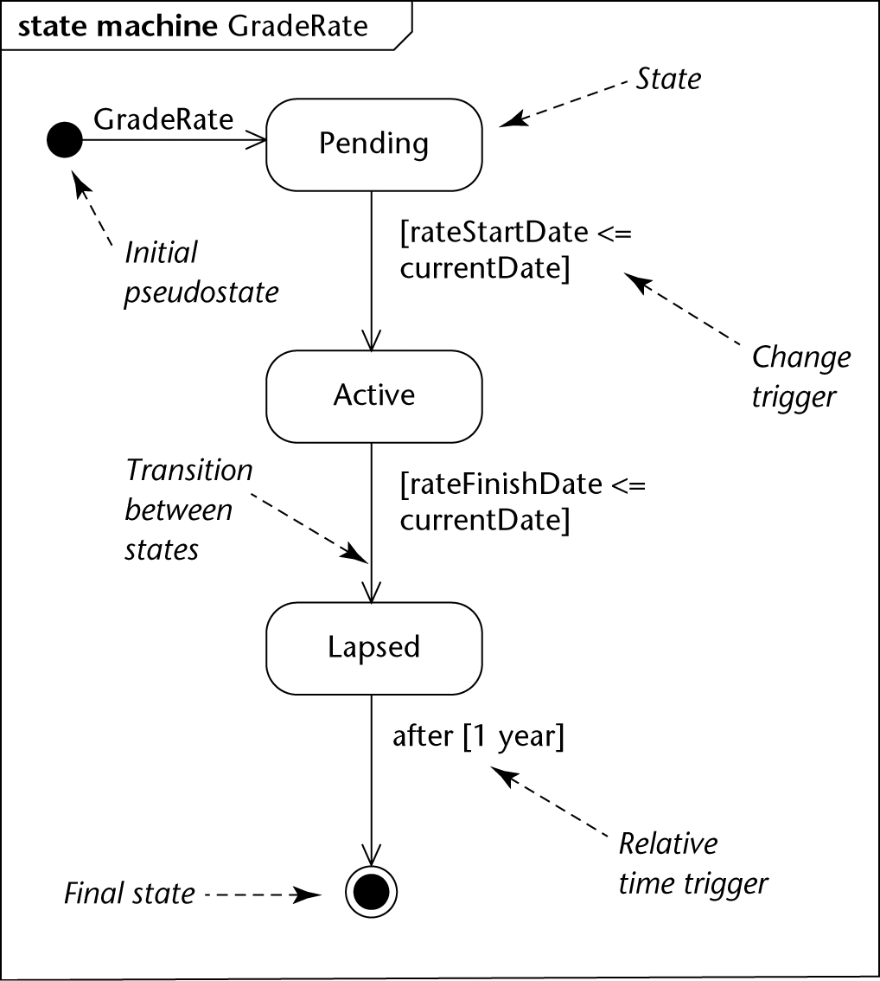
State Machine
Notes:
So here is the state machine diagram for the GradeRate object. Let’s start at the top, where the || initial pseudostate points to the starting state, so we know that when the GradeRate object is created, it is in the Pending state. We use this || rounded rectangle to represent a state. The arrows linking the states show how the object moves from one state to another, and we call the arrows || transitions.
To go from Pending to Active state, the system has to detect that the rateStartDate is before or equal to the currentDate. If this happens, then we move from Pending to Active. This is written inside square brackets, and is called a || change trigger. We have another change trigger to move from Active to Lapsed state.
Here’s a rule that we didn’t mention before. We don’t want to keep this GradeRate object in the system forever, we only want to keep it in the system for a year after it has lapsed, maybe for auditing purposes. Therefore, after a year, we want to destroy or delete this object from the system. To do this, we use a || relative time trigger, which uses the keyword “after” followed by the amount of time passed inside square brackets. Finally, to show that the object is removed from the system, we use a circled black dot notation, which is known as a || final state. Hope that makes sense.

Slide 10
Types of Triggers (or Events)
A change trigger occurs when a condition becomes true
A call trigger occurs when an object receives a call of one of its operations either from another object or from itself
A relative-time trigger is caused by the passage of a designated period of time after a specified event (frequently the entry to the current state)
A signal trigger occurs when an object receives a signal (an asynchronous communication)
Notes:
In the previous example, we introduced a few of new terms, like change triggers and relative-time triggers. There are actually 4 different types of triggers, or events, that are possible in state machines.
You have already seen an example of a || change trigger, which is when the system detects some change that happens in the system. This is a condition that is placed in square brackets. Specifically, a transition via a change trigger will happen when the condition in the square brackets becomes true.
On the other hand, a state change often does not happen automatically, Instead it happens when the system receives some input, like a mouse click or a text input. This is essentially a function call that causes a change to the object’s attribute values or links to other objects. This type of event is known as a || call trigger, which is when one of the object’s operations is called. We’ll show you an example of a call trigger in the next slide.
We have also seen an example of a || relative-time trigger, which will happen after a specified amount of time after a specified event, such as 1 year after entering the state. As we have seen, this uses the “after” keyword followed by the time amount in square brackets.
Finally, the last type of event is called a || signal trigger, which happens due to an asynchronous signal, like a kill message from the OS. We won’t go into signal triggers much in this module, just be aware that it exists.

Slide 11
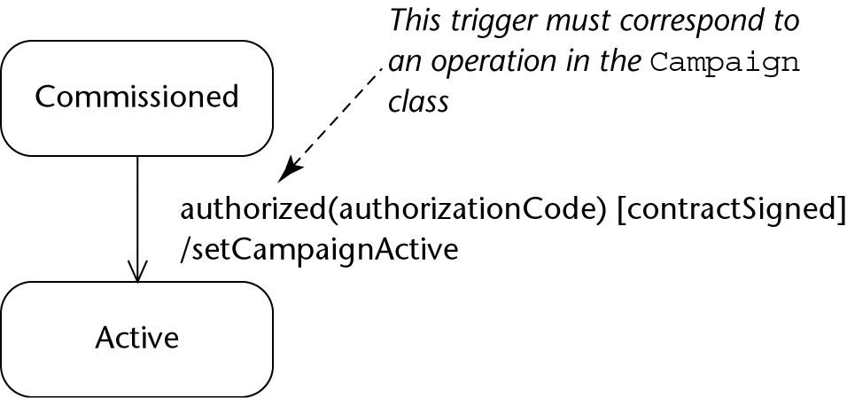
Call Trigger in Campaign class
Guard condition
Action
Notes:
Here is an example that demonstrates all the various parts of a call trigger. This is the partial state machine for a Campaign class in our advertising agency case study. We see that a Campaign might be commissioned, meaning that there is a plan to start an advertising campaign. But in order for it to become an actual Active campaign that the agency will work on, some things need to happen.
Firstly, someone must call the || authorized() operation in the Campaign class, and enter the authorizationCode as an argument. You have seen this kind of notation before: it is identical to a function call in a sequence diagram. But before you actually perform the transition, there is an additional condition that must be checked, which is given || here in square brackets. This is known as the guard condition, and if this condition is not true, then the transition does not happen. In other words, you can call the authorized operation in the Campaign class and all the code in that operation still runs, but if we see that the contractSigned variable is not set to True, then the transition does not happen and Campaign stays in the Commissioned state.
Now, assuming that contractSigned is True and the authorized operation is called, then the Campaign object will go to the Active state. Before it enters the Active state, however, it will || call the setCampaignActive operation of the Campaign object. We denote this with a slash followed by the function call, and this is known as an Action. It’s a bit confusing because there are no brackets at the end of setCampaignActive even though it is a function call. That’s because UML specifies that for state machines, if there are no arguments to an operation, then you leave out the brackets.
And that’s how a call trigger works.

Slide 12
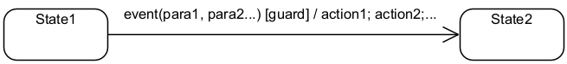
Transitions
A transition is fired when the following conditions are satisfied:
The entity is in the state of the source state
An event specified in the label occurs
The guard condition specified in the label is evaluated to be true
When a transition is fired, the actions associated with it are executed
Notes:
The notation for all 4 different trigger types follows the same rules || as given here. We have the event with parameters, if any, the guard condition in square brackets, then a list of actions after a slash, separated with semicolons. When a transition happens, || we say that it fires. Officially, in order for a transition to fire, 3 things must happen: First, the || object must of course be in the source state, which is the state at the start of the arrow. Second, the || event specified must occur, if any. If there is no event specified, then we assume that the transition is sort of “always on”. Third, the || guard condition must be evaluated to be True. If there is no guard condition, then it is assumed that the condition is True by default. All parts of these labels are optional.
Finally, when || a transition is fired, the actions after the slash are all executed before entering the next state.

Slide 13
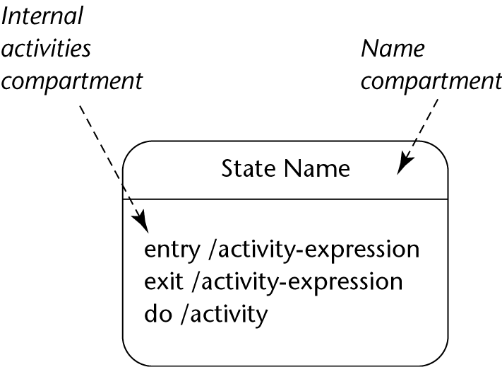
Internal Activities
Notes:
In all the state machines we have shown you so far, a state is just a name in rounded rectangle. Actually, UML allows you to specify a lot more detail about what goes on while the object is in a state. This diagram shows the notation that is used. We separate the state into 2 compartments. In the top compartment, we write the name of the state. In the bottom compartment, which is called the internal activities compartment, we provide information on what happens when the object is in the state. Specifically, we specify what happens when the object first enters the state, what it does just before it leaves the state, and what it does while it is in the state.

Slide 14
UML Notation
Action or activity | Description
entry/ action 1; …; action n | Upon entry to the state, the specified actions are performed once.
exit/ action 1; …; action n | Upon exit from the state, the specified actions are performed once.
do/ activity | The specified activity is performed continuously while in this state.
Notes:
Let’s formally explain what each of these internal actions mean. To specify || entry actions, you use the keyword “entry”, followed by a slash, followed by all the actions that happen separated by semi-colons. These actions are done exactly once, as the first things done when you enter the state.
To specify || exit actions, the notation is very similar. You use the keyword “exit”, then a slash, followed by all the actions separated by semi-colons. These actions are done just before you leave the state, and these actions are all also done exactly once.
The do activity is different. Unlike the entry and exit activities, you will do the do activity continuously as long as you are in this state. You will specify this with the keyword “do” followed by the activity after a slash.

Slide 15
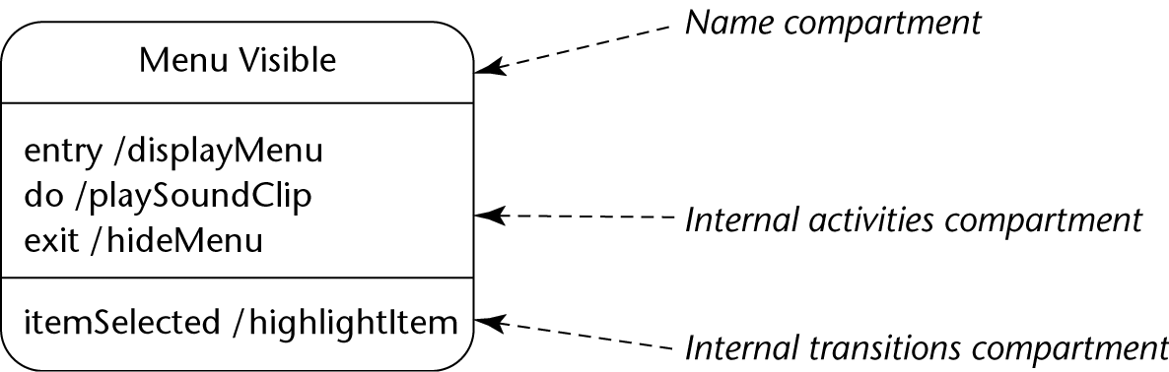
Internal Activities
Notes:
Here is an example that hopefully helps you understand what all these internal activities are meant to do. In this example, we have a menu object, and one of its states is called “Menu Visible”. We write that || in the name compartment here.
So how does the Menu Visible state work? Well, we see form the || internal activities compartment that when we first enter the state, we call the displayMenu operation, which presumably causes the menu choices to appear. We also see from the do actions that while the menu is in this state, we will continuously play a sound clip. Finally, when the object leaves the Menu Visible state, just before it leaves, it will call the hideMenu operation.
But wait, what is this other third compartment? This is called the || internal transitions compartment, which is where you can put more information are not entry, exit or do actions. In this case, we see that if the itemSelected operation is called, then we also highlight the item. Don’t worry too much about the internal transitions compartment, we seldom go into that much detail in practical projects, but if you do want to do so, then UML allows that.

Slide 16
State Machine for Campaign Class
Action-expression assigning manager and staff on object creation
/assignManager;
assignStaff
Commissioned
Authorized(authorizationCode)
[contractSigned]
/setCampaignActive
Active
campaignCompleted
/prepareFinalStatement
paymentReceived(payment)
[paymentDue - payment > zero]
Completed
paymentReceived(payment)
[paymentDue - payment <= zero]
Recursive transition models any payment event that does not reduce the amount due to zero or less.
Guard condition ensuring complete payment before entering Paid
Paid
archiveCampaign
/unassignStaff;
unassignManager
Notes:
Right, so now you have seen many of the various ways that UML specifies state machines. We will end off this lesson with another example from our textbook. This is an initial state machine for the Campaign class. We know from the initial pseudostate that when a campaign is created, it is in the Commissioned state by default. Notice || this interesting expression in the transition from the initial pseudostate, which starts with a slash followed by a couple of actions. We call this an action-expression, and what this says is that when you create the Campaign object, you must also assign the manage and the staff to this object.
As we have seen before, in order to go from Commissioned to Active, the || authorized operation must be called, and the contract must be signed. If so, then we call setCampaignActive() and go to the Active state.
While in Active state, the campaign in reality is going on. Eventually, the campaign will be completed, so someone will call || the campaignCompleted() operation in order to move the object to the Completed state. Before that happens, though, we must perform the action prepareFinalStatement. ||
Now let’s take a look at Completed state. There are actually 2 ways to leave the Completed state. One way is when we call paymentReceived, and find that || the amount that the client paid is not enough to cover the payment due. In this case, the paymentReceived operation is still carried out, but after that, the object returns to the Completed state. This type of transition, where the starting and end state is the same, is called a recursive transition. It is important to note that if the Completed state had exit and entry actions, both will occur as a result of this transition. The other way to leave the Completed state is if || the payment received is sufficient to cover the cost, as specified by the guard condition. In this case, we will transition to the Paid state.
Finally, how do we get out of the Paid state? In this case, we see that when the || archiveCampaign operation is called, the system will first unassign the staff and manager, and then delete the object from the system, as shown by the final state symbol.
OK, that looks pretty good. Except hold on, this state machine allows the client to overpay. What if the requirements change and we don’t want to allow that?

Slide 17
Revised State Machine for Campaign
/assignManager;
assignStaff
Commissioned
Authorized(authorizationCode)
[contract signed]
/setCampaignActive
If the user requirements were to change, so that an overpayment is now to result in the automatic generation of a refund, a new transition is added.
Active
campaignCompleted
/prepareFinalStatement
paymentReceived(payment)
[paymentDue - payment < zero]
/generateRefund
paymentReceived(payment)
[paymentDue - payment > zero]
Completed
paymentReceived(payment)
[paymentDue - payment = zero]
Paid
archiveCampaign
/unassignStaff;
unassignManager
Notes:
Well then we adjust the state machine. Suppose it is later decided that overpayment will now result in the automatic generation of a refund, then the state machine can be changed as follows. Everything is still the same except that we || adjust the condition to allow transitioning to the Paid state when the payment is exactly equal to the amount due; and we also || add a new transition to handle overpayment. In this case, we see that if the client overpays, we will call the generateRefund operation as an action before we go to the Paid state.

Slide 18
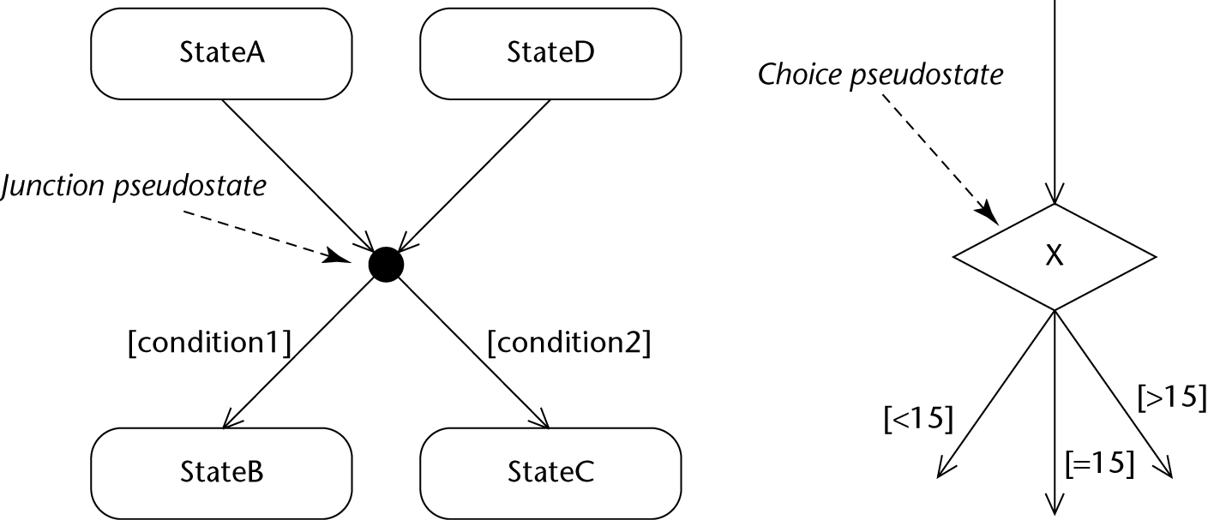
Junction & Choice Pseudostates
Notes:
OK, the last couple of things we’ll introduce in this lesson are something called junction and choice pseudostates. A junction pseudostate in UML is just a black dot. In this example, we see multiple transitions going into the junction, and multiple transitions coming out. Which state you end up in depends on whether condition1 or condition2 is true. So that’s pretty straightforward, except that you have to be careful when you set your guard conditions. If you end up at a junction and none of the conditions are true, you’re stuck, and that’s like your program hanging, so that should never happen. However, if multiple conditions are true, UML says that the object can end up in any of the resulting states and there is no priority. While legal, this is usually not a good idea, and this would be considered an ill-formed state machine.
Another way to add some decision making to the state transitions is by using a choice pseudostate as shown || here. In UML, a choice pseudostate is a diamond. Officially, choice pseudostates can only have one incoming transition and multiple outgoing transitions. Like the junction pseudostate, which state you end up in is determined by the guard conditions, in this case, whether the value of x is less than, equal to, or greater than 15.
Note that junction pseudostates are meant for static conditions, meaning that what the conditions are checking do not change during runtime. Choice pseudostates are meant for dynamic conditions, where you determine the resulting state by checking values that change over the course of running the program.

Slide 19
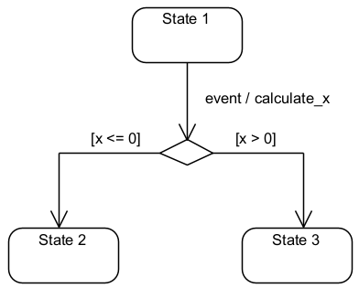
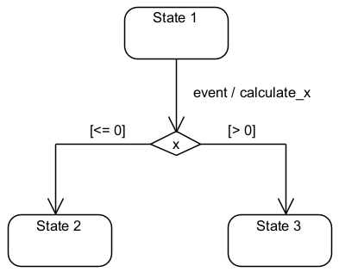
Choice Pseudostate Notation
Notes:
A quick note on the notation for choice pseudostates. These two partial state machines do the same thing: when the event triggers, we will calculate the value of x. Then, if x is less than or equal to 0, we follow the left transition, and if it is greater than 0, we follow the right transition. Both notations are legal, but when the transition is based on a single value, we should use the notation on the right, because || that notation more clearly shows that the decision is based on the value of x.

Slide 20
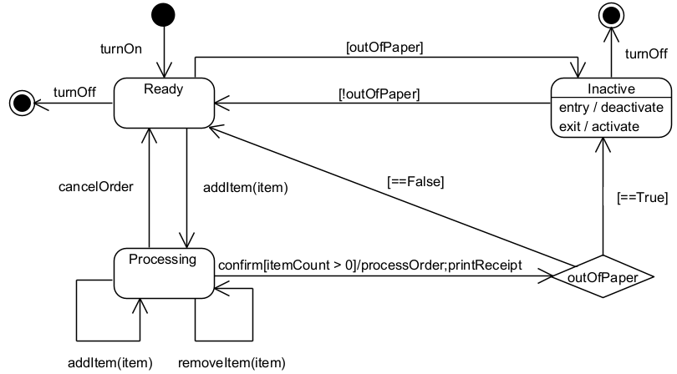
State Machine Example
Notes:
Let’s finish off this lesson with another example that puts all the elements we have discussed together into one state machine diagram. This is a state machine that models the life cycle of a cash register. We start at the || initial pseudostate, which tells us that when the cash register is turned on, it goes to the || Ready state. While in the Ready state, a few things can happen. The user can || add an item to an order by scanning its bar code. Once that happens, the cash register goes to the || Processing state. When in the Processing state, the user can || add more items or || remove items previously added, but this keeps the cash register in the Processing state. Alternatively, they can || cancel the order, which will return the cash register to the Ready state.
Finally, they can || confirm the order. The guard condition shows that this event only triggers if the number of items is greater than zero, otherwise nothing happens. Assuming there is at least one item in the order, the cash register will || process the order, and then print a receipt. Next, this || choice pseudonode will check whether the cash register is out of paper. If it is || not, we will just go back to the Ready state. But if the cash register || is out of paper, we instead go to the || Inactive state. The moment we step into the Inactive state, the entry action says that we call deactivate, which presumably turns off the ability to process orders. To get out of this state, we can replace the paper, whereupon || this change trigger will detect that we are no longer out of paper and go to the Ready state. Note that when we exit the Inactive state, the exit action shows that we will call the activate action so that we can start processing orders again.
|| Other than that, notice a few other details. This || change trigger shows that we can go from the Ready to the Inactive state if we are out of paper, which might happen if the cash register has no paper when we turn it on. Finally, notice that we can only || turn off the cash register while in the Ready and Inactive states – we are not allowed to turn it off while in the Processing state. So this diagram describes quite clearly how this specific cash register behaves, and now you know how to read state machine diagrams.

Slide 21
Summary
What is a state
What is a state machine
Notes:
So that’s the basics of state machines. We talked about what is a state and how objects in systems often have states that affect their behavior. We also talked about what is a state machine, which is just a model that explains how an object behaves based on its state, and how that object changes states. Hopefully, it is clear to you why it is convenient to map out the life cycle of objects in a system that you are implementing in order to make sure that it is behaving in the way that you intend it. So, how do we code state machines? Well, that’s where the State design pattern comes in, which we will cover next week.
By the way, you know how water can be in a solid, liquid or gas state? There was once a creature made of water that went from liquid to gas state and died. His gravestone said “You will be mist.” Byee!

